Slide 1

Kasatria dashboard
Name: Van Hoang Nam Nguyen

Slide 2
Content
Question 1: Item type that gains max profit is in which countries?
Question 2: Total cost, revenue and profit by location and item type?
Question 3: How many orders of beverages are there in 2011?
Question 4: Which region has longest average delivery time in 2016?
Question 5: Which item type contributes most profit in Jan?
Question 6: Total profit of top 5 countries by orders from online channel?

Slide 3
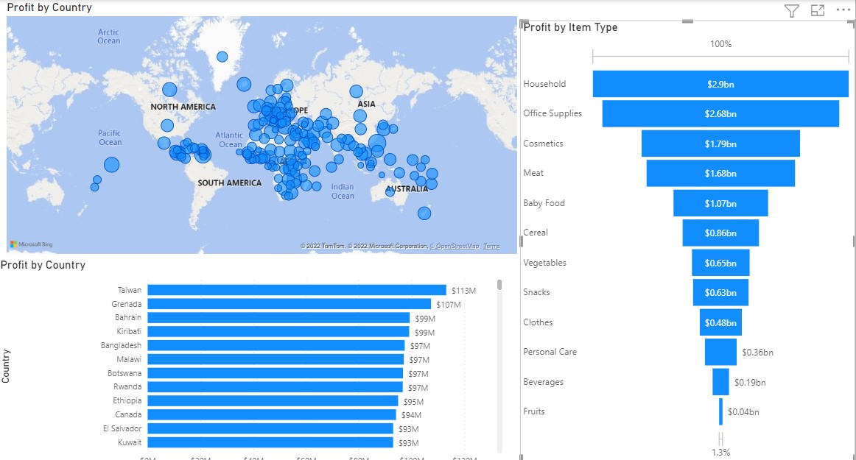
Question 1: Item type that gains max profit is in which countries?
Methods:
Use map to show profits of countries to define which country had the highest profit
Revenue = unit_sale* price
Profit = Revenue - cost
Use bar chart and funnel to show profits by countries and item type
Analysis:
The most profits were in Europe & Asian
Household & office supplies accounted for over 50% of total profits
The most profits was in Taiwan and Grenada
The most profits of household products were in Grenada & Bahrain
The most profits of office supplies were in Taiwan & Rwanda

Slide 4
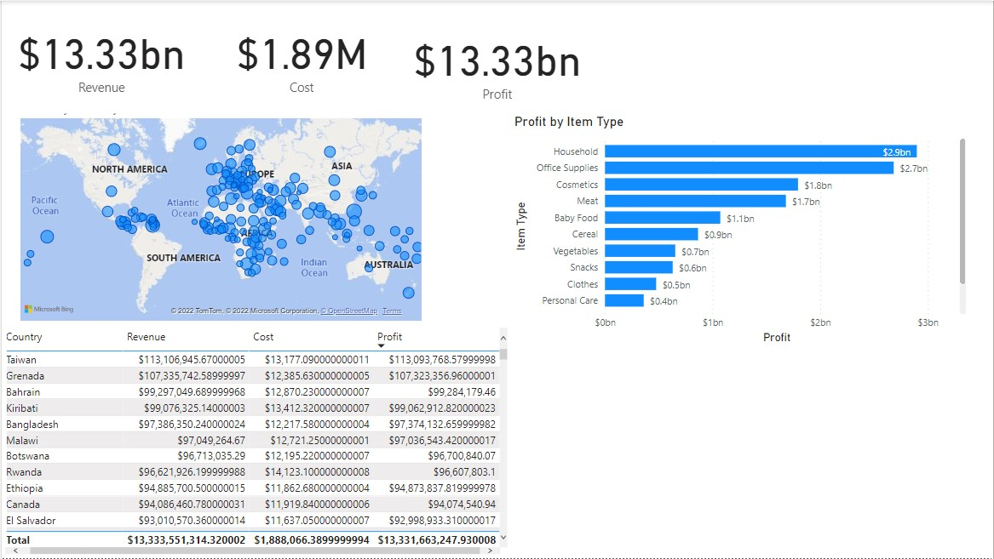
Question 2: Total cost, revenue and profit by location and item type?
Methods:
Revenue = unit_sale* price
Profit = Revenue - cost
Use map to show profits of countries to define which country had the highest profit
Use bar chart and funnel to show profits by countries and item type
Use table to show Revenue, Cost and profit
Analyses
The most revenue were in Europe & Asian
Household & office supplies accounted for over 50% of total revenues
The most spending was in Taiwan and Grenada
The most revenue of household products were in Grenada & Bahrain
Renvenue was as 650 times as cost

Slide 5
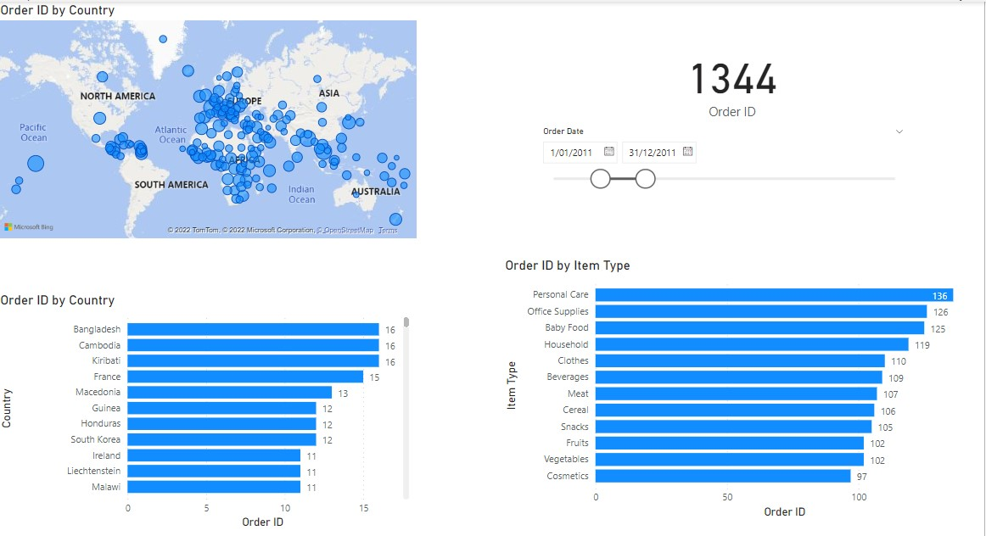
Question 3: How many orders of beverages are there in 2011?
Methods:
Use map to show total orders of countries to define which or had the highest orders
Use bar chart to show total orders by countries and item type
Use card to show total orders
Use slicers to show order date in 2011
Analyses:
There were 1,344 orders
Beverage (109 orders) accounted for 8.1% in the total orders by item type

Slide 6
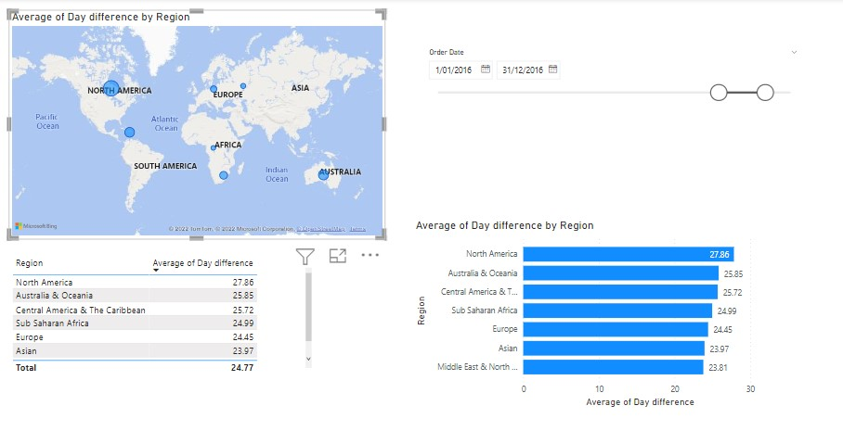
Question 4: Which region has longest average delivery time in 2016?
Methods:
Day difference = Ship date – Order date
Average day difference
Use add a conditional column to country to create region column
Use map to show average date difference of regions to define which region had the longest average date difference
Use bar chart and table show average date diffence by region
Use slicers to show order date in 2016
Analysis:
North America has the longest average delivery time in 2016 (27.86 days)

Slide 7
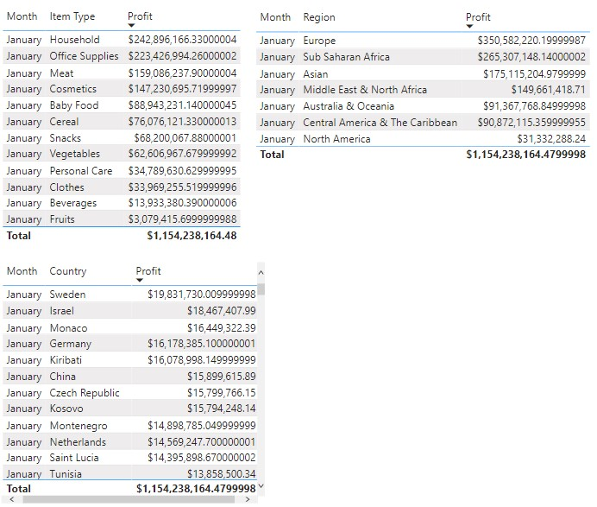
Question 5: Which item type contributes most profit in Jan?
Methods:
Use basic filter to choose January only
Revenue = unit_sale* price
Profit = Revenue - cost
Use tables show profits by item type, region and countries
Analysis:
Household and office supplies contribute most profits in January
Sweeden and Israel contributes most profits in January
Europe and Sub Saharan Africa accounted for the highest profits in January

Slide 8
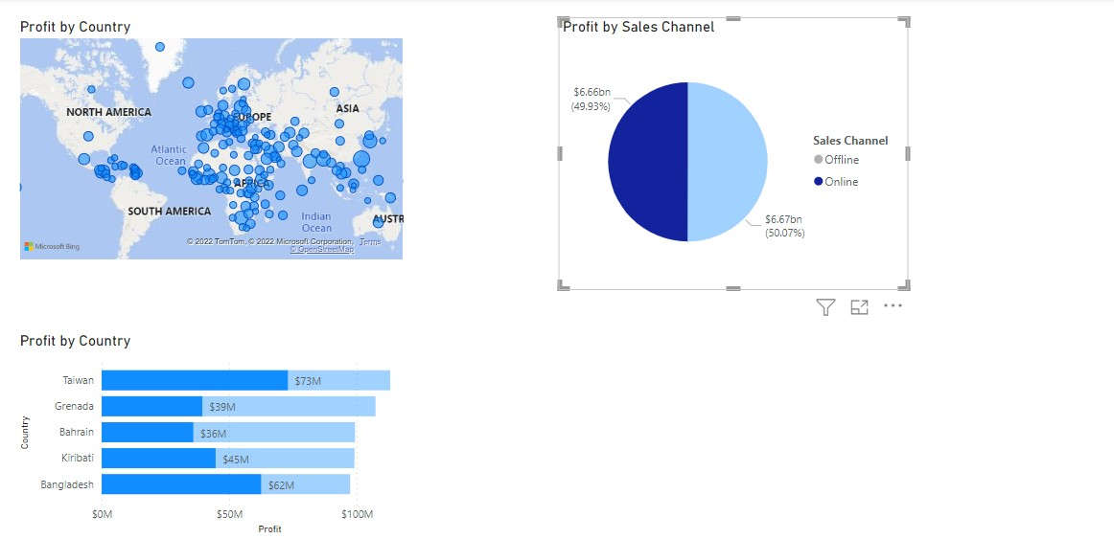
Question 6:Total profit of top 5 countries by orders from online channel?
Methods:
Use map to show profits of countries to define which country had the highest profit
Revenue = unit_sale* price
Profit = Revenue - cost
Use bar chart to show profits by coutry
Use pie chart to show profit by sales channel
Select Top N operator to choose 5 countries having the highest profit
Analyses:
Total profit of top 5 countries by orders from online channel includes: Taiwan, Grenada, Bahrain, Kirbati and Bangladesh

Slide 9
Conclusions:
Europe and Asian will be the markets that bring the highest profits
Home and office supplies are the company's best-selling items
Household demand in Grenada and Bahrain, and demand for office supplies in Taiwan and Rwanda
Beverages accounted for 8.1% of total orders by item. North America had the longest average delivery time in 2016.
Household and office furniture contributed the most profit in January
Sweeden and Israel contributed the most profits in January
Europe and Sub-Saharan Africa accounted for the highest profits in January
Total profit of top 5 countries by orders from online channel includes: Taiwan, Grenada, Bahrain, Kirbati and Bangladesh

Slide 10
Recommendations
Improve the company's delivery speed to increase the revenue (especially in North America)
Carry out research & development to improve the quality of household and office supplies
Expand different online sale channels: SEO + onlineshop, marketplace, affiliate programs, google shopping,..... in Taiwan, Bangladesh
Create system of point reward for each purchase to loyal customers
Attach sample gift of low-profit products to increase in approaching to customers

